Slide 1
Customer Churn Prediction Model Using ML
Presented by: Dhanasekaran V
Course: Data Science and Data Analytics
Batch: April 2025

Slide 2
Introduction
Customer churn means customers stopping their service.
Predicting churn helps companies retain customers.
Machine Learning is used to identify which customers are likely to leave

Slide 3
Customer Data
Model
Prediction
Retention
Problem Statement & Objective
Many customers stop using services suddenly.
Objective: To predict churn using machine learning models.
Also, group customers using K-Means clustering to understand their behavior

Slide 4
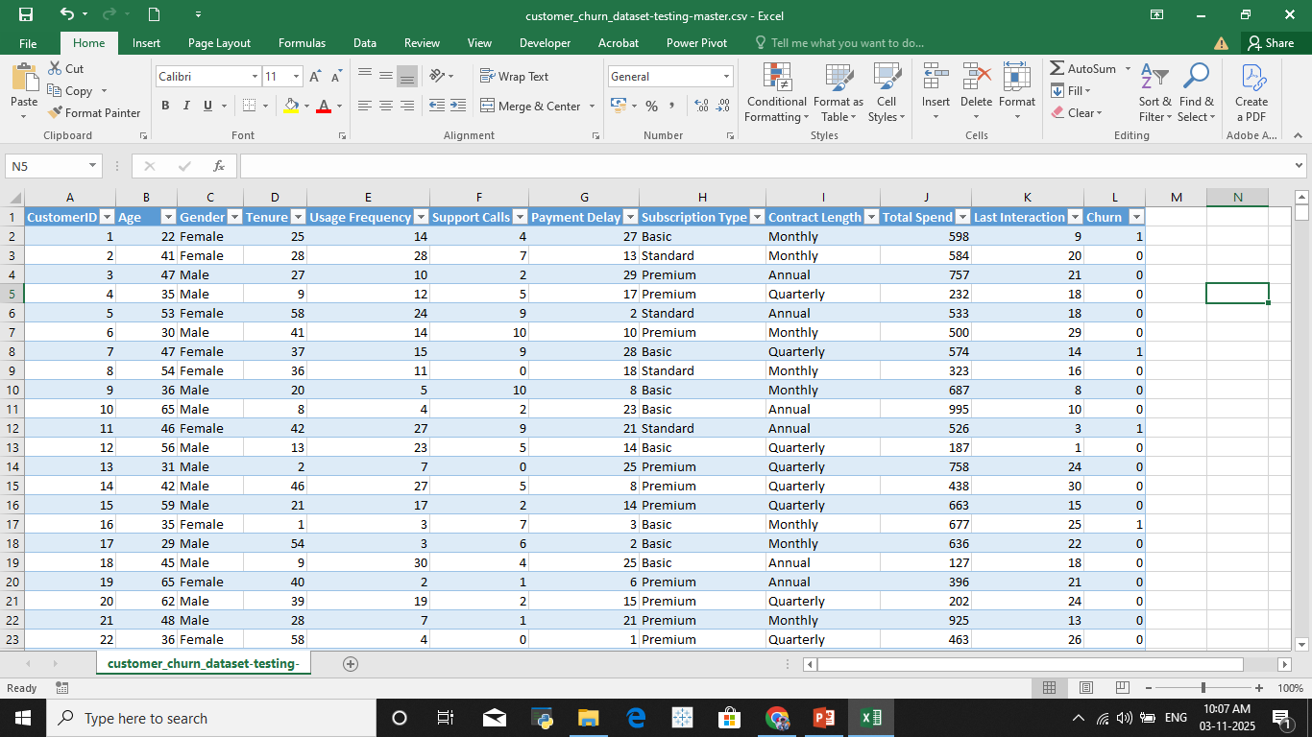
Dataset Overview
Data from a telecom company’s customer records.
Includes info like gender, contract type, tenure, and monthly charges.
Target variable: “Churn” (Yes/No)

Slide 5
Data Pre-processing
Raw Data
Cleaning
Encoding
Model Ready
Removed missing and duplicate values.
Encoded categorical data into numbers.
Scaled numerical data for better model performance.
Split data: 80% training, 20% testing.

Slide 6
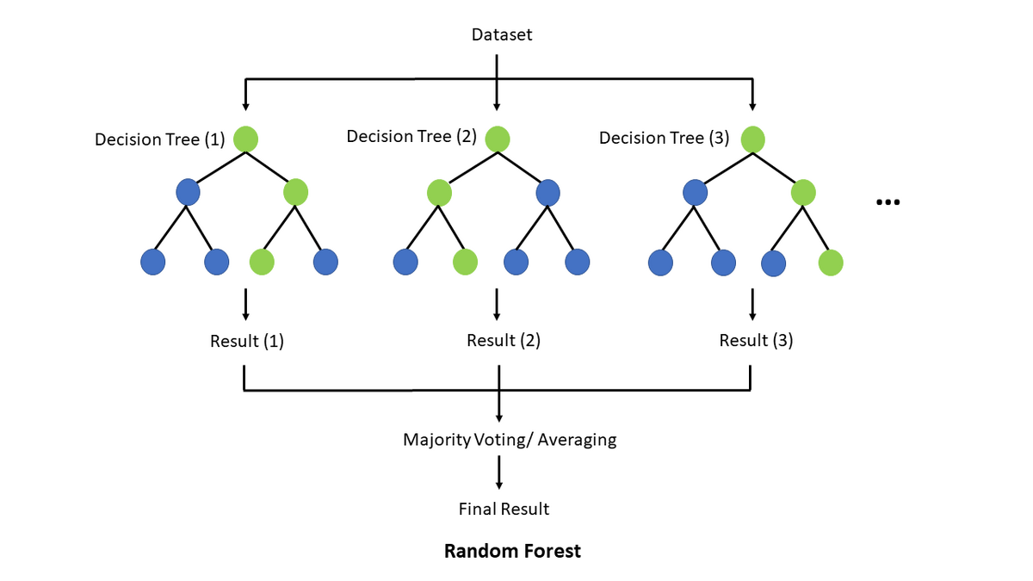
Model Building - Supervised Learning
Used Random Forest Classifier to predict churn.
Trained model using customer features.
Output: Churn prediction (1 = churn, 0 = stay).

Slide 7
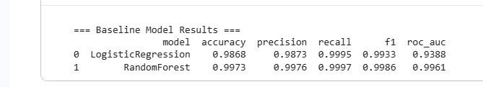
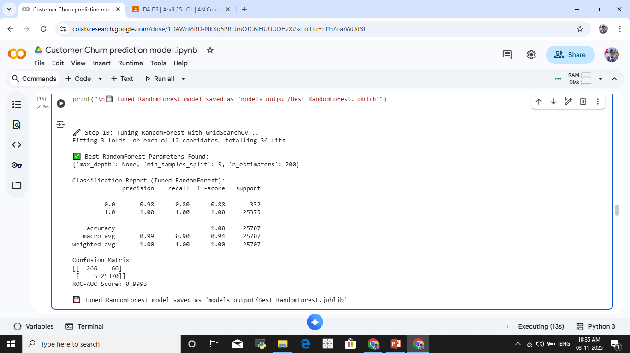
Model Tuning with GridSearchCV
Before Tuning :
Tuned Random Forest hyperparameters using GridSearchCV.
Evaluated using ROC-AUC score and cross-validation.
Saved best model as “Best_RandomForest.joblib”.
After Tuning :

Slide 8
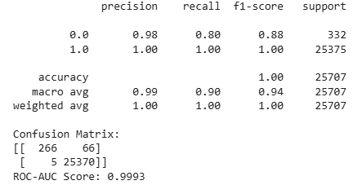
Model Evaluation
Evaluated using Accuracy, Precision, Recall, F1 Score, ROC-AUC.
High accuracy achieved, showing good performance.
Confusion matrix shows model predictions clearly.

Slide 9
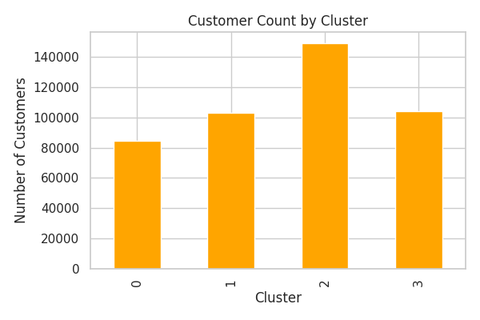
Clustering K-Means – Unsupervised Learning
Applied K-Means to group customers by behavior.
Determined optimal clusters using Elbow Method.
Found segments like “High Risk”, “Medium Risk”, “Loyal

Slide 10
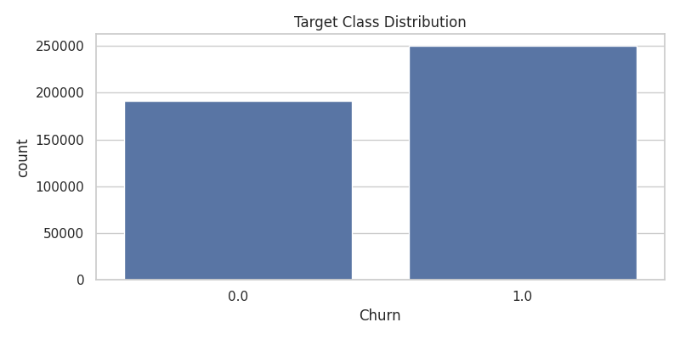
Visualization and Insights
Visualized churn distribution and key patterns.
Found that higher monthly charges increase churn risk.
Long-tenure customers are more loyal.

Slide 11
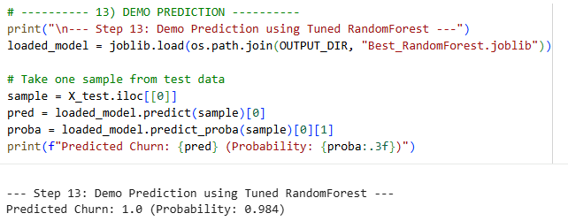
Demo Prediction
Used saved model to predict churn for one test sample.
Output: Predicted Churn = 0.0 (Probability: 0.010)
Shows the model’s real-time working ability.

Slide 12
Conclusion
Model predicts churn with good accuracy.
K-Means clustering gives deeper customer insights.
The Random Forest Can is Best model To prediction

